Slide 1
Agile Enterprise Architecture

Slide 2
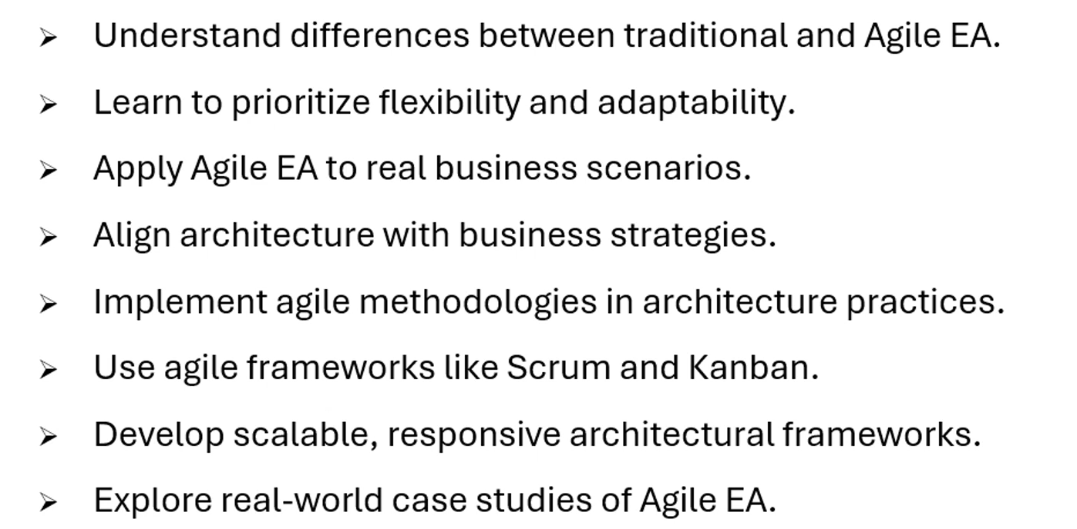
Course Objectives

Slide 3
Thank You

